Slide 1
2026 Draft Operating and Capital Budget
November 12, 2025
Notes:
Chief

Slide 2
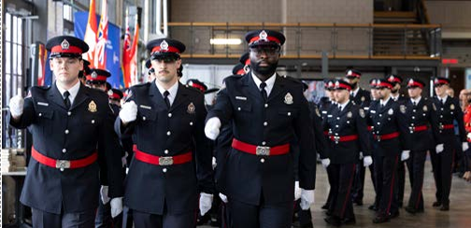

Overview
Budget Development
Policing in Ottawa
2026 Budget Highlights
Budget Proposal
Next Steps
Notes:
Chief?

Slide 3

Budget Development
Notes:
Steve

Slide 4






Budget Timeline
September 5
Mid September
Late September
September 29
November
12
November 13 - December 5
November
21
December 5
December
10
Finance
& Audit Committee
Senior Leadership Team Review
Executive Command Final Review
Budget Directions Report
Budget Tabling
Budget Consultations
Finance
& Audit Committee
Board Approval
City Council Approval
Notes:
Chief

Slide 5
PSB Budget Directions
Prepare the 2026 Draft Operating and Capital Budgets based on the following:
Approve the 2026 budget review and approval timetable
That the Ottawa Police Service:
No more than a 6.5% tax increase; and
Expected assessment growth of 1.6%
Notes:
Chief

Slide 6
Budget
Recommendations
Receive and table the Ottawa Police Service 2026 Draft Operating and Capital Budget.
That the Ottawa Police Services Board:
Approve the Ottawa Police Service 2026 Draft Operating and Capital Budget at the Board meeting on December 5th, 2025.
Direct staff to prepare and execute a multi-year efficiency plan at the Board meeting on December 5th, 2025.
Direct staff to prepare a four-year long range financial plan in 2026 for the period of 2027 to 2030 at the Board meeting on December 5th, 2025.
Direct staff to report back to the Finance and Audit Committee regularly during development of the four-year long range financial plan for the period of 2027 to 2030 and the efficiency plan, beginning in 2026, and to report on progress thereafter.
Approve the delegation of authority to the Chief of Police to execute and administer the 2026 Fleet Replacement Program, up to a maximum of $6.5 million.
Approve the delegation of authority to the Chief of Police to execute and administer the 2026 Conducted Energy Weapon (CEW) Program, up to a maximum of $1.8 million.
Notes:
Chief

Slide 7

Recommendations Rationale
The OPS requires an investment at the top end of the City of Ottawa budget guidelines in order to:
  Provide adequate and effective policing in the City of Ottawa;
  Deliver on the Board’s strategic plan and key performance indicators;
  Adhere to obligations made in the ratified collective bargaining agreements with the Ottawa Police Association and the Senior Officer’s Association;
  Implement the third year of the three-year staff stabilization plan, and pilot body worn cameras.
  In Budget 2025, OPS forecasted 10.6% police tax rate increase plus 1.5% assessment growth (total of 12.1%). For budget 2026, to line up with City of Ottawa budget guidelines, we have reduced our base budget request to 5% plus 1.6% assessment growth. OPS was also provided 0.6% of base budget funding from PILT's for a total base budget increase of 7.2%.
Notes:
Chief

Slide 8
Budget Approach
Guided by a comprehensive consultation effort and operational insights
Designed to deliver on Board's Strategic Plan and build public trust​
Addresses current and future needs of policing with staged investments
Considers the financial demands and pressures resulting from the CBAs with the SOA and OPA
Prioritizes long-term Operational Stability ​
Customizes community policing to address local needs
Advances equity and human rights
Notes:
Chief

Slide 9

Budget Consultation
Broad consultation aligned with CSPA 2019 / OPSB policy CR-6 to reflect community voices in the 2025 budget.​
Engaged interest holders (community/OPS members) to better understand policing needs.​
Feedback gathered via mixed methods informs public safety priorities and resource allocation.
Notes:
Chief

Slide 10
Budget Consultation
Leadership Connections:
👥 Direct conversations with councillors, residents, and community leaders led by OPS leadership.
Community-Centric Engagement:
🌍 Meetings, dialogues, and surveys to include as many voices as possible.
Inclusive Data Collection:
🗣️ Input gathered across languages, cultures, and platforms to reflect Ottawa’s diversity.
Data-Driven Insights:
📊 Analyzed ward needs, service pressures, and benchmarks to guide decisions.
Notes:
Chief

Slide 11
What We Heard
Trust in OPS is holding steady but remains uneven across wards and groups.
Top priorities: gun and gang prevention, de-escalation training, and mental health response.
Rising concern about response times and police service capacity.
Residents want OPS to treat everyone fairly and focus on equity.
Many residents feel crime is rising, especially violent crime and drug-related issues.
Residents want visible community presence and prevention programs.
Notes:
Chief

Slide 12
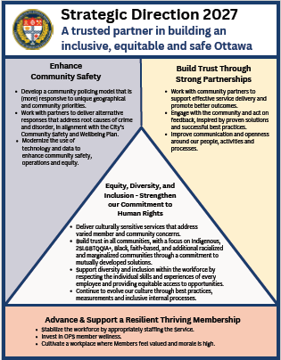
Strategic Direction
The Board’s Strategic Direction approved in November 2023 were:
Enhance Community Safety
Build Trust Through Strong Partnerships
Equity, Diversity and Inclusion – Strengthen Our Commitment to Human Rights
Advance and Support a Resilient, Thriving Membership
Notes:
Chief

Slide 13
Strategic
Direction
32 projects aligned with Strategic Direction 2027
1 project funded by Federal Government
6 projects funded by Provincial Government
Enhance Community Safety
Building Trust Through Strong Partnerships
Advance and Support a Resilient Thriving Membership
EDI – Strengthen our Commitment to Human Rights
District Revitalization Project
CSPA Compliance
Next Generation 9-1-1
Enterprise Asset Management
Data Optimization Project
Safer Streets Initiative
Fleet Service Delivery
Mental Health Strategy
Radio Upgrades
Joint Air Support Unit (Prov)
Parliamentary Precinct (Fed)
Mounted Patrol Unit (Prov)
Market Safe (Prov)
CORE (Prov)
Alternative Mental Health Supports (Prov)
Community Relations Management System
Community Safety and Well-Being Framework
Victim Choice/Virtual Victim Reporting
Military Veterans and First Responders Program
Body Worn Camera
Customer Service Review
Staff Stabilization Initiative
South Facility​ Project
Safe Workplace Program
Parade Formation Framework
Wellness Program
Employee Central (SAP) Modernization
FSP Updates
Alternative Staffing- Project Complement/Special Constables Initiative (Prov)
EDI Drive2 Strategy
Use of Force Community Case Review
Race and Identity Base Data Strategy
13
Annual Budget plus special purpose Federal/Provincial funding enables strategic projects to deliver on Board strategic plan.
Notes:
Chief

Slide 14

Policing in Ottawa
Notes:
Chief

Slide 15
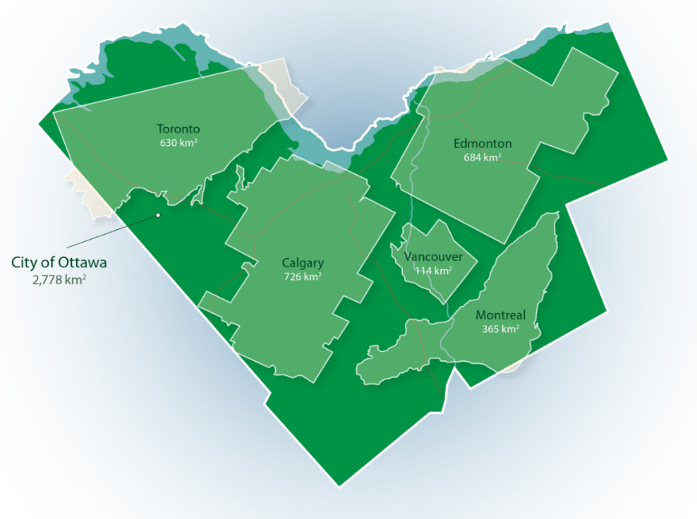
Policing in Ottawa
Population: 4th largest city: 1M+ residents; 475K households
Diversity: 1/3 Ottawa residents identify as visible minorities
Education: Highly educated population, 37% higher than the Ontario average
Income: Household income is 18% higher than the Ontario median. Nearly 9% of households are under the low-income measurement and growing.
Geography: Rural, Suburban, Urban
Notes:
Chief

Slide 16




Policing in Ottawa
Between 2015 and 2024 demands for service have been growing.
Citizen-generated calls
Response times slowing
11%
2024: 160,000
Priority
2015
2024
Change
1
8
8 min
Service time (Hrs)
45%
2024: 389,500
2
12
14 min
19%
3
17
56 min
227%
Police reports
11%
4
50
109 min
120%
2024: 103,000
Figures from 2024. Change % from 2015 to 2024.
Calls for Service reflect only citizen-initiated requests, mobile response. Service Times include only citizen-initiated calls with mobile response.
Notes:
Chief

Slide 17









Policing in Ottawa
Between 2015 and 2024 the volume of crime is up 63% to 50,600 offences.
Violent Crime: up 58% to 8,200 offences.
Assaults
Uttering Threats
Sexual Violations
Homicides
61%
167%
45%
200%
Average shootings
per year: 65
2024: 4,500
2024: 1,200
2024: 900
2024: 21
Persons injured by firearm up 12% to 19 in 2024.
Property Crime: up 64% to 35,800 offences.
Shoplifting
Mischief
Auto Theft
Clearance Rate (%)
384%
13%
113%
Declined by 10% to 26% in 2024.
2024: 12,100
2024: 3,400
2024: 1,700
Figures from 2024. Change % from 2015 to 2024 | Homicides Incidents | Volume of crime excluding Traffic offences.
Clearance Rate (%): Total incidents cleared (by charge or otherwise) divided by the total reported incidents.
Notes:
Chief

Slide 18
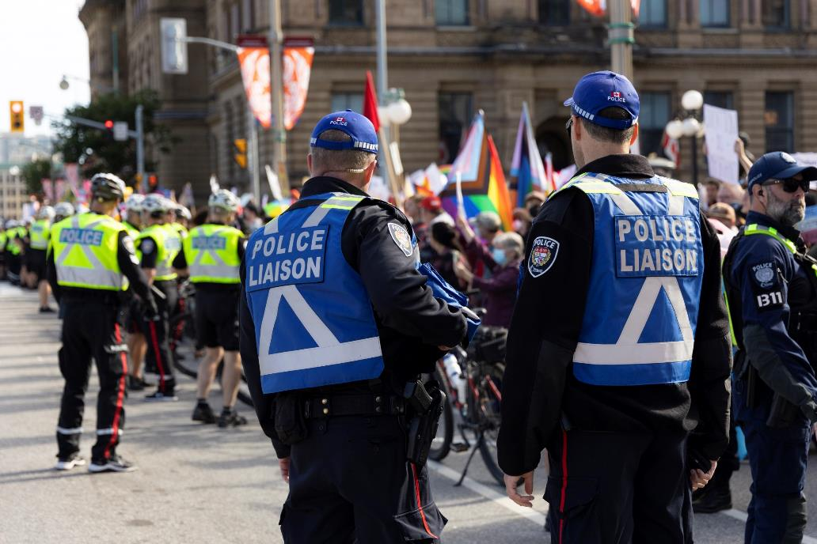
Policing in Ottawa
Crime Severity Index
Largest 12 municipalities by population in Ontario:
4th lowest
Weighted Clearance Rate
Largest 12 municipalities by population in Ontario:
2nd lowest
Violent Crime Severity Index
Largest 12 municipalities by population in Ontario:
3rd lowest
Officers per Population
Largest 12 municipalities by population in Ontario:
5th lowest
Sources: 1. Statistics Canada Table: 35-10-0188-01 (formerly CANSIM 252-0085). Release date: 2024-07-25. Crime severity index and weighted clearance rates, police services in Ontario. 2. Statistics Canada Table: 35-10-0026-01 (formerly CANSIM 252-0052). Release date: 2024-07-25. Crime severity index and weighted clearance rates, Canada, provinces, territories and Census Metropolitan Areas. 35-10-0077-01 (formerly CANSIM 254-0004). Release date: 2024-03-26. Crime severity index and weighted clearance rates, police services in Ontario. Police personnel and selected crime statistics, municipal police services.
Notes:
Chief

Slide 19



Policing in Ottawa
Between 2020 and 2024, sick leave and overtime hours have been growing.
Sick Leave Hours
34%
Average Sick Leave*
2024: 559,000
Sworn
12 days
9%
Civilian
15 days
0%
Over time Hours
226%
2024: 250,900
Regular Overtime
2024:
$ 18.5M
2026 target:
$ 16.2M
Absenteeism Rate
3%
2024: 13%
Figures from 2024. Change % from 2015 to 2024. | Non-Recoverable Regular Overtime, excludes: court, stat holiday, and paid duty overtime
* Sick leave has declined year to date in 2025.
Notes:
Chief

Slide 20
Relevant Benchmarks
Board Approved Police Tax Rate Increase for Big 12 in Ontario:
Service | 2022 Budget Increase | 2023 Budget Increase | 2024 Budget Increase | 2025 Budget Increase | Average
Peel | 4.8% | 8.2% | 14.0% | 21.3% | 12.1%
London | 2.80% | 1.6% | 22.4% | 10.6% | 9.4%
Durham | 4.5% | 6.1% | 8.3% | 16.9% | 8.9%
Halton | 4.2% | 5.7% | 9.5% | 14.3% | 8.4%
Niagara | 4.5% | 5.7% | 5.9% | 12.7% | 7.2%
Sudbury | 4.7% | 5.7% | 8.1% | 6.2% | 6.2%
Waterloo | 4.0% | 7.4% | 4.5% | 8.7% | 6.2%
Hamilton | 3.9% | 5.4% | 6.9% | 5.7% | 5.5%
York | 4.5% | 3.9% | 4.6% | 7.7% | 5.2%
Windsor | 1.60% | 2.0% | 6.3% | 7.1% | 4.3%
Toronto | 2.3% | 4.3% | 1.7% | 3.9% | 3.1%
Ottawa | 2.0% | 2.5% | 2.5% | 2.9% | 2.5%
Average | 3.7% | 4.9% | 7.9% | 9.8% | 6.6%
Key Takeaway: OPS has the lowest average police tax rate increase over past 4 years of the Big 12 in Ontario. Collective agreement settlements have been trending upwards from 2% to 3-4%.
Notes:
Chief

Slide 21
Relevant Benchmarks
Rank | Service | Population | Land area | Authorized police officer strength (budget) | Total number of civilian and other personnel | Total | Population per Authorized Police strength
1 | Montreal | 2,032,845 | 498 | 4,751 | 1,086 | 5,837 | 428
2 | Vancouver | 707,667 | 115 | 1,448 | 513 | 1,961 | 489
3 | Edmonton | 1,087,172 | 766 | 1,895 | 1,104 | 2,999 | 574
4 | Winnipeg | 783,096 | 462 | 1,362 | 602 | 1,964 | 578
5 | Toronto | 3,025,647 | 631 | 4,988 | 3,170 | 8,158 | 607
6 | Calgary | 1,413,800 | 821 | 2,174 | 965 | 3,139 | 650
7 | Peel | 1,517,448 | 1,247 | 2,286 | 991 | 3,277 | 664
8 | York | 1,224,244 | 1,758 | 1,735 | 770 | 2,505 | 706
9 | Ottawa | 1,071,868 | 2,788 | 1,493 | 620 | 2,113 | 718
10 | Waterloo | 633,828 | 1,369 | 834 | 423 | 1,257 | 760
11 | Durham | 745,580 | 2,521 | 978 | 364 | 1,342 | 762
12 | Halton | 627,200 | 966 | 788 | 334 | 1,122 | 796
Ottawa Rank |  | 7 | 1 | 7 | 7 | 7 | 9
Key Takeaway: Ottawa has largest land area, low police strength to population and moderate crime.
Source: CANSIM Table 254-0004 Police personnel and selected crime statistics, municipal police services Statistics Canada
Notes:
Chief

Slide 22

2026 Budget Highlights
Notes:
Steve

Slide 23
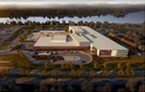
Highlights
District Policing
  A tailored model of policing that addresses the unique needs of urban, suburban and rural
Staff stabilization and growth (25)
  Frontline, District, Training (CSPA), Special Constables
Absorption of known CSPA costs
Salary and benefit costs for the OPA and SOA collective agreements
Continuation of the Facilities Strategic Plan, including the Professional Development Centre
Body-Worn Cameras
Notes:
Steve / Chief

Slide 24
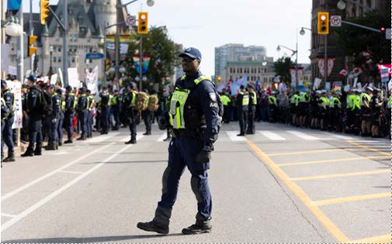
Highlights
Continuation of Provincially and Federally funded new services, including:
Parliamentary Precinct
Alternative Mental Health Support Initiative
Alternative Staffing Special Constable Initiative
Community Outreach Response and Engagement
Mounted Unit
Byward Market Initiatives
Notes:
Steve

Slide 25

Budget Proposal
Notes:
Jon

Slide 26
Budget Proposal
 | 2026 Draft Budget
Base Budget increase | $26.1 M
Net Operating Budget | $414.9 M
Assessment Growth – 1.6% | $5.7 M
Payment in Lieu of Taxes – 0.6% | $2.1 M
Police Tax Rate increase – 5% | $18.3M
Estimated tax increase on average urban household | $36
Estimated 2026 Police Costs for average urban household | $753
Notes:
Jon

Slide 27
Draft Operating Budget
Budget Changes |  | ($M)
Maintain services Negotiated Contract Settlements Staffing Stabilization Plan | $ | 30.5
FTE Growth 25 additional resources |  | 2.3
New Services Parliament Precinct $2.2M in expenses and revenue Strategic Projects $5.4M in expenses and Tax Stabilization One-Time Funding |  | -
Efficiencies |  | (4.3)
User fees and revenues |  | (2.4)
Base Budget increase | $ | 26.1
Funded by:
Assessment Growth (1.6%) | $ | 5.7
Payment in Lieu of Taxes (0.6%) | $ | 2.1
Police Tax Rate increase ($) | $ | 18.3
Police Tax Rate increase (%) |  | 5.0%
Notes:
Jon

Slide 28

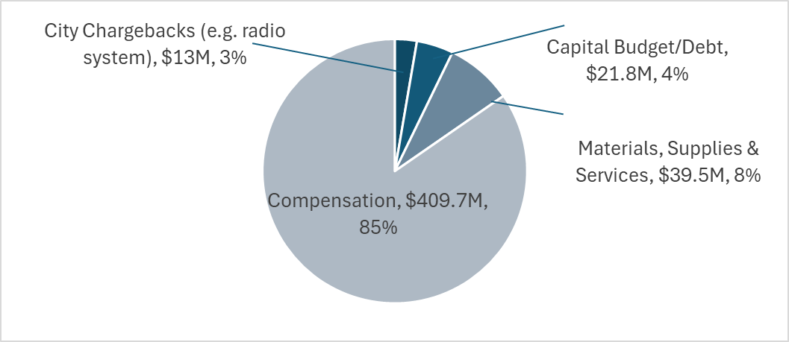
2026 Draft Operating Budget
Gross Operating Budget | $484.0M
Recovery Allocations | ($5.3M)
Gross Operating Budget (less recovery allocations) | $478.7M
Revenue | ($63.8M)
Net Operating Budget | $414.9M
5.0%
GROSS BUDGET BREAKDOWN ($M)
Notes:
Jon

Slide 29
Capital Budget
2026 Capital Budget
2026 to 2035 Capital Budget Forecast
Capital Project | Total Cost ($M)
Renewal of Assets
Fleet Program | $ 6.4
IT Infrastructure | 2.4
Lifecycle of Specialized Assets | 1.8
IT Telecommunication | 2.4
Facility Lifecycle | 2.9
Subtotal | $ 15.9
Growth & Strategic Initiatives
Radio Project | $ 4.4
Growth | 2.2
Facility & Security Initiatives | 0.8
Subtotal | $ 7.4
Total | $ 23.3
Category | Total cost ($M)
Renewal of Assets | $209.8
Growth | $0.0
Strategic Initiatives | $26.8
Total | $236.6
PAYG 99%
Notes:
Jon

Slide 30
Efficiencies
Capital and Technology
  Apply technology to achieve outcomes in strategic projects and service delivery.
  Capital contribution deferral plan to manage near-term budget pressures.
  Lower fleet maintenance and fuel costs through investing in telematics technology.
  IT efficiency review to find cost savings.
  Leverage IT and analytics to enable service optimization and process improvements (ex: BWCs).
Service and Staffing
  Conduct a full service review.
  Span of control review to ensure affordable and effective supervision.
  Reduce administrative costs and overhead through streamlining.
  Increase use of Special Constables to provide cost-effective support.
  Reduce operational reliance on the use of overtime.
  Reduce sick leave costs through wellness, scheduling, and improved supports.
Notes:
Bill

Slide 31
Long Range Financial Plan
In addition to the service efficiency exercise, in 2026, the Service is developing a four-year Long Range Financial Plan to help guide and manage future operational needs while providing predictability around potential tax increases. This Plan will address risks associated with one time funding.
Approach aligns with practices in other Canadian police services and is designed to ensure fiscal sustainability and strategic alignment.
The plan will consider: population growth projections, crime trend analysis, infrastructure and equipment needs, staffing forecasts, and anticipated service demands across urban, suburban, and rural communities.
The Plan will incorporate insights from community consultations, performance metrics, and legislative requirements to ensure transparency and accountability.
Notes:
Bill

Slide 32
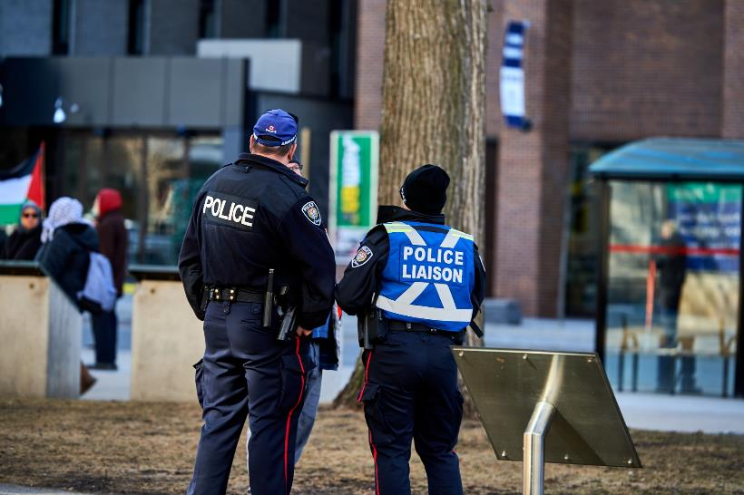
Inherent Risks
Unsustainable OPS Budget
  Working with Board and City on solutions
Pending retirement wave
  Associated staffing & leadership challenges
  Leadership development and succession planning strategy being developed to mitigate
Escalating workforce budget pressures
Significant CSPA implementation costs
Continued reliance on temporary funding sources/ solutions (Provincial and Federal grants, Municipal one-time funding)
Risk of ongoing OPS operating budget deficit
Notes:
Steve

Slide 33
OPS Capital Strategy and Plan
Capital budget risk exists commencing in 2027 due to: depletion of capital reserve, reduction of pay as you go contributions, lifecycle deferrals and inability to absorb upcoming pressures (long-term training facility solution).
OPS will develop a capital strategy and plan as part of the long range financial plan.
Plan will cover all categories included in the capital budget including:
  1) Renewal of assets including IT, Fleet, Facilities and Specialized Equipment;
  2) Growth;
  3) Strategic Initiatives including an updated facilities strategic plan.
Required to support the Board strategic plan and OPS strategic projects.
Notes:
Steve

Slide 34

Next Steps
Notes:
Steve

Slide 35
Community Feedback
We welcome and value opportunities for collaborative discussions that provide meaningful feedback on the OPS 2026 Budget
Engagement | Date
OPS Draft Budget Feedback Survey - https://www.ottawapolice.ca/en/who-we-are/budget.aspx | November 12 - December 5
City Councillor Budget Briefings | Ongoing
Outreach initiatives with Indigenous, racialized, marginalized community stakeholders and diverse community groups | November 12 - December 5
Finance and Audit Committee | November 21
Notes:
Steve

Slide 36

Questions
Notes:
Chief

