Slide 1

District Revitalization Project
Ottawa City Council Technical Brief
30 April 2024
A/Superintendent Kevin Maloney

Slide 2

Purpose
Provide Ottawa City Council an update on the following aspects of the District Revitalization Project:
OPS Community Policing Strategy
Pilot Deployment Model start date
What to expect in the next four months
Current District Mapping
New District Inspectors
2

Slide 3
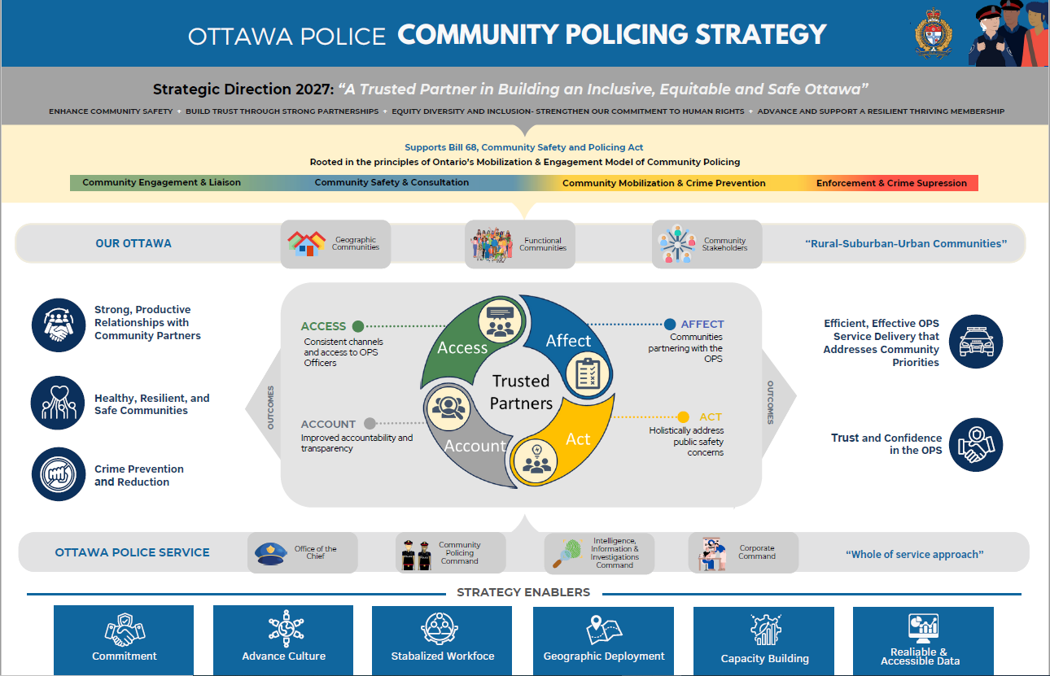
Enforcement & Crime Suppression
3

Slide 4

Pilot Deployment Model
Part I
Part II
Part III
Part IV
Part V
Pilot Deployment Model
Part I Start
Pilot Deployment Model
Part II Start
Pilot Deployment Model
Part III Start
Pilot Deployment Model
Assessment
6 May 24
June
July
August
September
October
November
December
January 25
February
March
April
May
January 26
Value added
4

Slide 5
What to expect in the next four months
A change in the way the OPS connects with you and the community
District Inspectors will begin working within the OPS Community Policing Strategy framework, focusing on Access and Affect
CSWB Director Abid Jan will provide community engagement support and build on stakeholder engagement and management
District priorities will be identified, and the District Inspectors will coordinate responses in consultation with their Chain of Command
5

Slide 6
The District boundaries are currently being defined and reviewed at an operational and tactical level to produce the best fit, supporting community needs through crime prevention and emergency response.
District Mapping & District Inspectors
West – Inspector Ian Hayes
HayesI@ottawapolice.ca
Wards: 4, 5, 6, 7, 8, 9 and 23
East – Inspector Marc-André Sheehy
SheehyM@ottawapolice.ca
Wards: 1, 2, 10, 11, 18, and 19
Central – Inspector Jeffrey Leblanc
LeblancJ@ottawapolice.ca
Wards: 12, 13, 14, 15, 16, 17
South – Inspector Isabelle Lemieux
LemieuxI@ottawapolice.ca
Wards: 3, 20, 21, 22, and 24
The Neighbourhood Policing Directorate remains under the leadership of Superintendent Ken Bryden. District activities will be supported by Director Abid Jan of the Community Safety and Well-being Branch.
6

Slide 7
How can you help?
Provide regular Community Policing and District Deployment updates through your communication channels as they are shared
Use the access points available to you (Community Police Officers and District Inspectors)
Help OPS connect and build relationships with geographic and functional communities and stakeholders
Share your Ward-level strategic plan and critical priorities
Be supportive and patient as the OPS evolves and incorporates the Community Policing Strategy principles
7

Slide 8

Questions and Feedback
Thank you!

